Slide 1
IT3708 - Bio-Inspired Artificial Intelligence
Ole J. Mengshoel
ole.j.mengshoel@ntnu.no
Professor, Department of CS, NTNU, Trondheim
Week 1, Spring 2023 Semester

Slide 2
Welcome! Today’s Agenda
Today’s Main Goal: For students to get an overview of the course, and understand whether this course is a good fit for them or not.
Contents of course (brief)
Overview of bio-inspired AI topics
Course objectives
Course structure
Textbooks and other materials
Course mechanics
Instructors
Times & places
Schedule & tasks
Web site – Blackboard
Grading
Brief introductions, if time permits

Slide 3
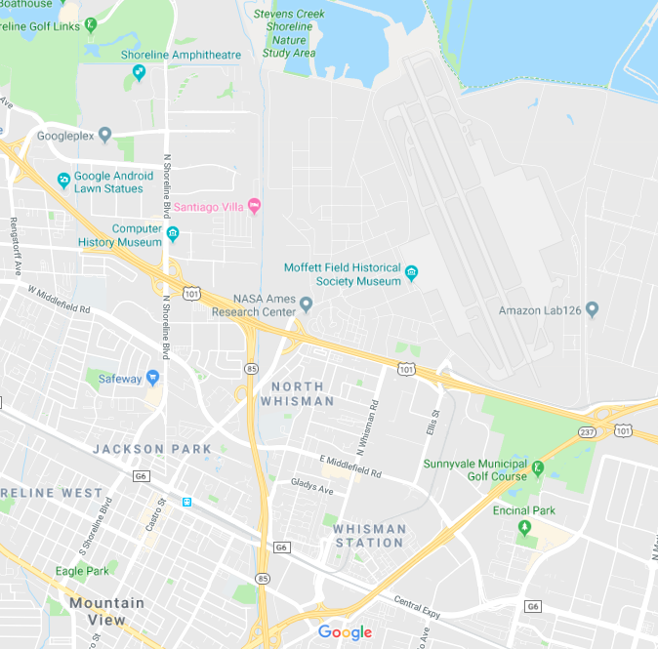
My background and Experience
Around 30 years in Norway, around 25 years in USA
Education: Siv. Ing. From NTH, Ph.D. from UIUC – both in Computer Science
Focus on AI since the late-1980s
Positions: SINTEF in Trondheim, Rockwell in SoCal and NorCal, USRA/RIACS at NASA Ames Research Center, Carnegie Mellon University (CMU) in Silicon Valley, NTNU in Trondheim
Experience at the interface of academia and industry
Around 15 years in Silicon Valley, California
Over 100 publications: AI Journal, AAAI, AISTATS, IEEE TKDE, IJCAI, JAR, KDD, UAI, …
4 U.S. patents
Currently:
Professor in Computer Science at NTNU since Fall 2018
Member of the Norwegian Open AI Lab
NASA Ames Research Center (ARC) and Carnegie Mellon University (CMU) in Silicon Valley

Slide 4
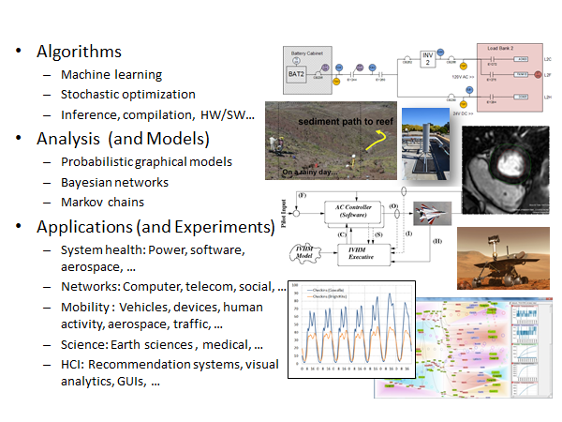
Overview: research in MengshoeL LAB
https://works.bepress.com/ole_mengshoel/

Slide 5
Course Staff
Lecturers:
Ole Jakob, Xavier
ole.j.mengshoel@ntnu.no
xavier.sanchezdz@ntnu.no
The Student (or Teaching) Assistants:
Anum, Helle, Martin
anum.masood@ntnu.no
hellevha@stud.ntnu.no
martieh@stud.ntnu.no
Coordinating Student Assistants: Anum, Helle
Main areas of responsibility for the Student Assistants:
Assist with the projects (exercises), as is typically the case in NTNU courses, including help with the “demo days”
Answer questions from students, during lab sessions and via Blackboard – especially as they related to programming projects
Potentially other things: to be decided (TBD)

Slide 6
Course Contents (brief)

Slide 7
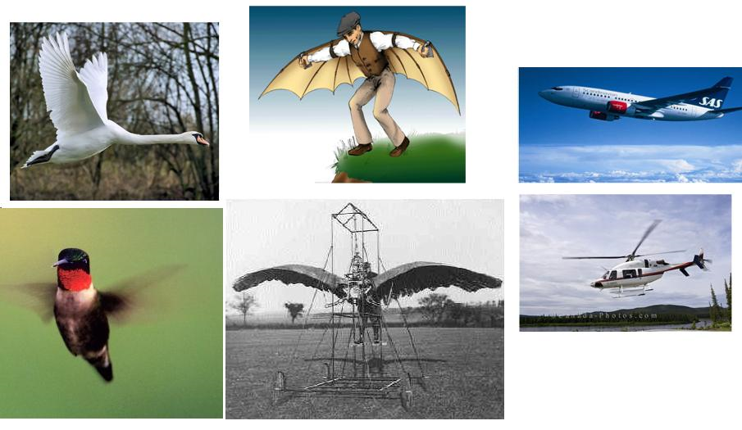
Abstraction in Flying and in (Bio-Inspired) Artificial Intelligence

Slide 8
Machine Learning “Tribes” [Domingos, 2015]
Evolutionaries: bio-inspired AI methods, especially from evolution and genetics – incl. evolutionary algorithms, genetic algorithms, and genetic programming [Darwin, 1859] [Holland, 1975] [Goldberg, 1989].
Connectionists: (deep) neural networks - reverse engineer the brain [Werbos, 1974] [Rumelhart & McClelland, 1986] [Bengio, 2009] [Goodfellow et al., 2016].
Bayesians: learning as inference using - Bayes rule, Bayesian networks, and probabilistic graphical models [Duda & Hart, 1973] [Pearl, 1988] [Jelinek, 1997][Darwiche, 2009] [Koller & Friedman, 2009] [Blake, 2011].
Symbolists: intelligence as symbol manipulation[Newell & Simon, 1976] [Michalski et al., 1983] [Breiman et al., 1984] [Quinlan, 1992].
Analogizers: learning by recognizing similarities [Boser et al., 1992] [Kolodner, 1993] [Cristianini & Shawe-Taylor, 2000].
Primary focus in this class.
Secondary focus in this class.
These “tribes” to a large extent also carry over to other areas of artificial intelligence, beyond machine learning.

Slide 9
Why Bio-inspired AI Works Well?
Improvements in hardware - computers are good at:
Fast computing: millions of simple operations per second
Accurately storing data: Huge memories - RAM, cache, disk, ...
Improvements in algorithms and software:
Focus in this course
(For data-intensive BioAI, for example in ML): Availability of large and interesting data sets:
Emergence of the Web and cheap sensing
No “real intelligence” needed:
We can start doing interesting bio-inspired AI work before human and animal intelligence is fully understood
Current bio-inspired AI approaches take advantage of what powerful computers are good at (plus – in the case of ML – the large data sets currently available)

Slide 10
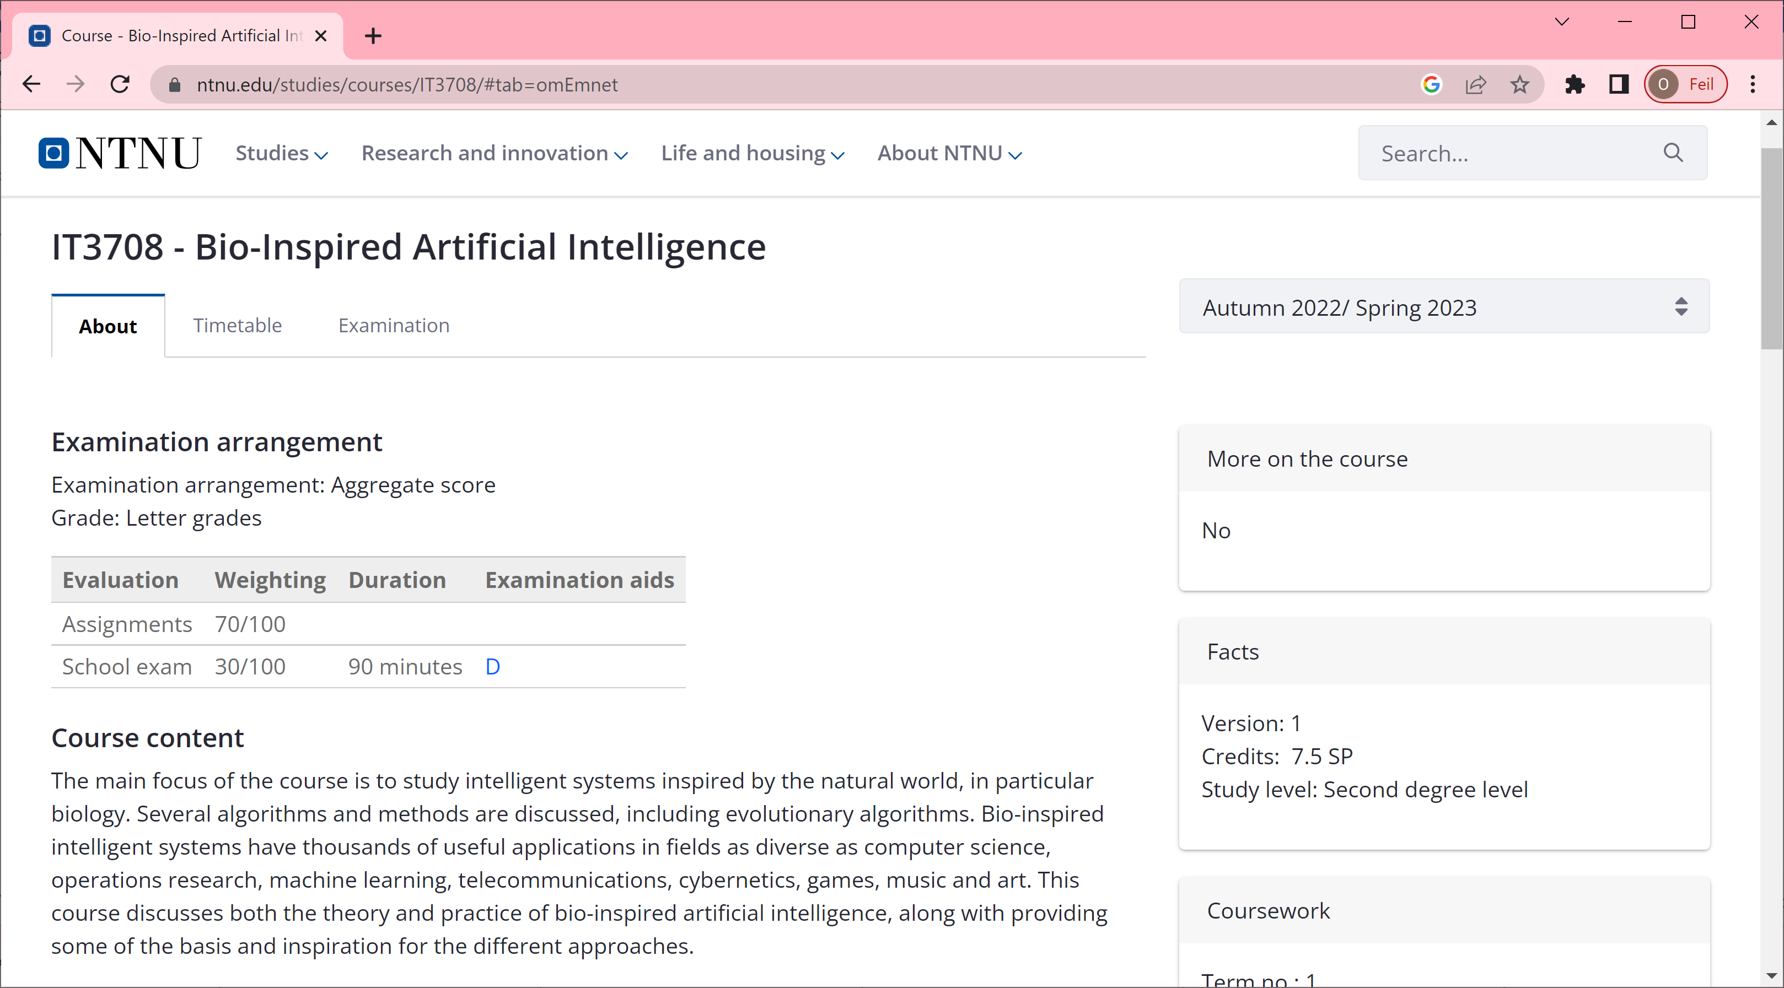
Course Objective and Description (1)
https://www.ntnu.no/studier/emner/IT3708
Portfolio evaluation with final grades A-F, 70% based on work (3 projects) and 30% on exam. This is similar to the previous few years.
Portfolio evaluation, not just evaluation in a single exam. So a shorter exam of 1.5 hours will take place.

Slide 11
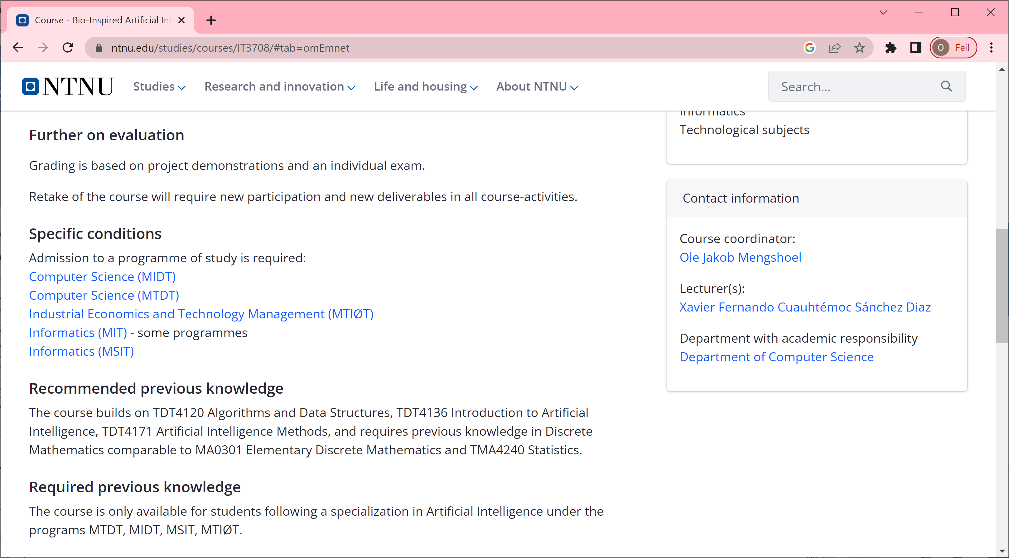
Course Objective and Description (2)
Portfolio evaluation: a certain number of excercises (in the form of 3 projects) are given scores. The scores will be part of the calculation of an A-F grade in the course.
The course is heavy on programming projects and targets computing students with an AI specialization. If you’re not experienced in computer programming, you may get in trouble. Ask question(s) to me or other course instructors if you’re in doubt about your background’s fit for the course.

Slide 12

Course Objective and Description (3)
If (1) you have the necessary (similar) background as described at the URL and (2) there is enough capacity, I am open to having you take the course.
I would encourage you to follow the first few lectures and exercises, and we (course instructors) are happy to discuss with students in this situation.

Slide 13
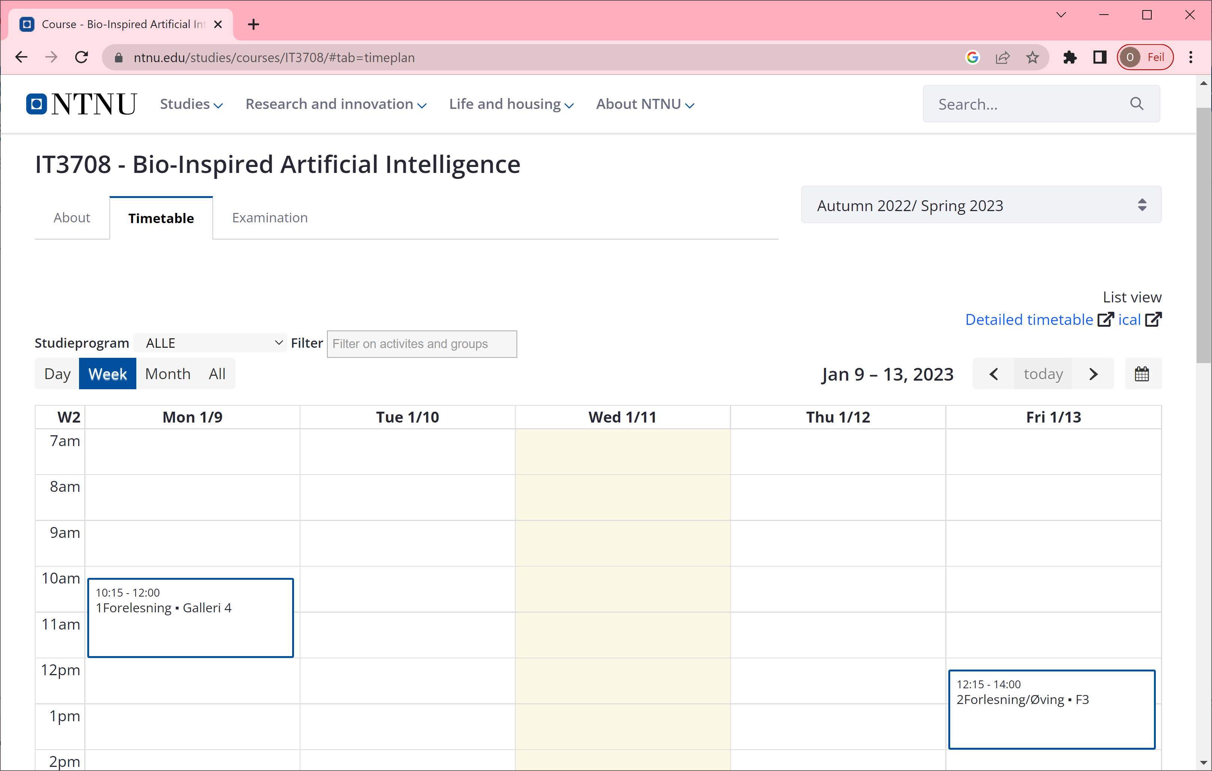
Course Objective and Description (4)
Mondays will be project meetings.
Fridays will be lectures.

Slide 14
Course Materials Include
Two main textbooks
“Evolutionary Optimization Algorithms,” by D. Simon, Wiley 2013
“Introduction to Evolutionary Computing,” 2nd Edition, by A. E. Eiben and J. E. Smith, Springer 2015
Lecture slides
Other materials, such as articles and papers
To be announced
(Other textbooks
“Genetic Algorithms in Search, Optimization, and Machine Learning,” by D. E. Goldberg, Addison-Wesley, 1989
“Multi-Objective Optimization using Evolutionary Algorithms,” by K. Deb, John Wiles & Sons, 2001
“Bio-Inspired Artificial Intelligence: Theories, Methods, and Technologies,” by D. Floreano and C. Mattiussi, MIT Press, 2008
…)

Slide 15
Course Topics: Bio-Inspired Artificial Intelligence (BioAI)
Introduction and background to BioAI
Optimization via BioAI
Hillclimbing or Stochastic Local Search
Genetic Algorithms
Evolutionary Programming
Evolution Strategies
Genetic Programming
Evolutionary Algorithm Variants
Differential Evolution
Ant Colony Optimization
Particle Swarm Optimization
Hybrid BioAI
Applications of BioAI
Theory of BioAI
Roughly, substantial parts of Part I and Part II from Simon’s book and Eiben and Smith’s book. Plus selected topics from Part III / Part IV of both books and other sources.
This list of topics is subject to change; specifics will be provided later.

Slide 16
Class Textbooks - Remarks
Benefit of printed copy of recommended textbook(s):
Recent and comprehensive resources on bio-inspired algorithms and applications
Aids, for many people, with study – add detail, questions, etc. with pencil
More comprehensive and (typically) more formal than lectures
Beneficial during work on programming projects, exercises, etc.
In addition to the textbook(s), there may be:
Articles and papers from journals and conferences
Guest lectures, some with recommended article(s) or paper(s)
Details will follow

Slide 17

Questions or
comments so far?
Faculty

Slide 18
Course Mechanics

Slide 19
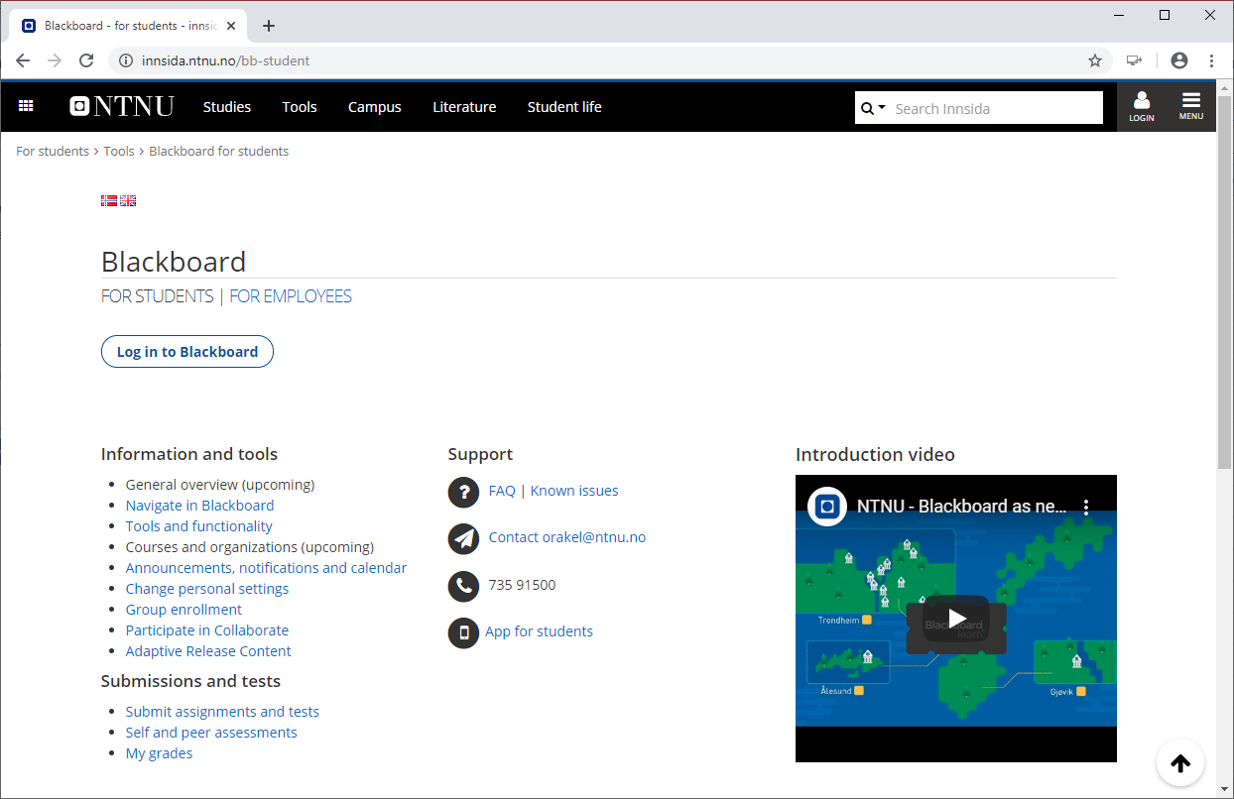
Course Web Site: Blackboard (BB) https://innsida.ntnu.no/bb-student
Make sure your name is on the class roster and you can log into Course Website (CW)! If it is not, and you think you registered, please let the ASA know by sending email!
Please use Blackboard, Lectures, and Lab for all general communications related to the course. Reserve emails to issues with strict privacy, personal, or similar concerns.

Slide 20
Course Projects
There are 3 programming projects, related to class topics
A student may or may not work in teams of > 1 students
If you don’t have a team, that’s not a problem; team size = 1 is okay
Expectations for projects are proportional to team size
Maximal team size is 2 students
Each student works on each course project and demonstration
Project demonstrations are on a per-team basis
However, each team member is the main responsible for (at least) one part of the deliverable
Be considerate of your teammate (if any)
Demonstrate your high-level commitment to the course projects
Think twice before you drop the course or change your commitment – if you drop the course, please drop early

Slide 21
Prerequisites for Course
Prerequisites:
Introductory AI course(s)
“Artificial Intelligence”
“Machine Learning”
Introductory probability, statistics, discrete math course(s):
“Statistics 101”
“Probability 101”
“Introduction to Discrete Math”
Programming course(s):
We will not teach programming in this course
The projects are quite programming intensive, and there’s 3 of them
A 4th year computer science or software engineering student is probably safe
No particular programming language is required or assumed
What if I’m (potentially) weak in one or more prerequisites?
You will be responsible for “catching up”:
You may be able to catch up in one prerequisite
However, catching up in two or three prerequisites will likely be quite hard, and is not recommended

Slide 22
Software Tools Generally
In the programming projects, programming languages and software tools will be key and hands-on programming and demonstration performance become important
This course does not require the use of specific software tools or programming languages
But: Tools must be “fast enough” to get through demonstrations – in a limited time (typically 20-30 minutes) – on demo day
In previous years, Python has been NOT recommended in certain projects; listen carefully to the advice from student assistants
No tool is perfect for all jobs
In particular, languages and tools are strong on different types of algorithms, optimization problem, exploratory data analysis, or visualization
The “best” tool depends on the goal of the project, your background and interests, …
Some especially important dimensions
How large problems or data sets can the tool handle efficiently?
Type of data (tabular, text, images, heterogeneous, …) constrains tool selection
How well-documented (on the Web, in the code, in reports, in books, …) and well-engineered is the tool?

Slide 23
Reference Group for Course
Need ~3 students to take part in 2 short meetings this semester
Minimal time commitment
Need to make yourself available to other students
So that you can represent your own and their inputs to the course
Benefits:
Impact on the course this and later semesters
Valuable collaboration and connections
Sign up at break, after the lecture, or by email:
ole.j.mengshoel@ntnu.no
xavier.sanchezdz@ntnu.no

Slide 24
Questions or
comments about course mechanics or similar?
Faculty

Slide 25
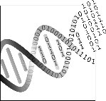
Evolutionary Systems

Slide 26
Machine Learning “Tribes” [Domingos, 2015]
Evolutionaries: bio-inspired AI methods, especially from evolution and genetics – incl. evolutionary algorithms, genetic algorithms, and genetic programming [Darwin, 1859] [Holland, 1975] [Goldberg, 1989].
Connectionists: (deep) neural networks - reverse engineer the brain [Werbos, 1974] [Rumelhart & McClelland, 1986] [Bengio, 2009] [Goodfellow et al., 2016].
Bayesians: learning as inference using - Bayes rule, Bayesian networks, and probabilistic graphical models [Duda & Hart, 1973] [Pearl, 1988] [Jelinek, 1997][Darwiche, 2009] [Koller & Friedman, 2009] [Blake, 2011].
Symbolists: intelligence as symbol manipulation[Newell & Simon, 1976] [Michalski et al., 1983] [Breiman et al., 1984] [Quinlan, 1992].
Analogizers: learning by recognizing similarities [Boser et al., 1992] [Kolodner, 1993] [Cristianini & Shawe-Taylor, 2000].
Main focus today – an overview follows below.
Note: Hybrids that combine or integrate two or more methods from these tribes are becoming more and more popular.

Slide 27
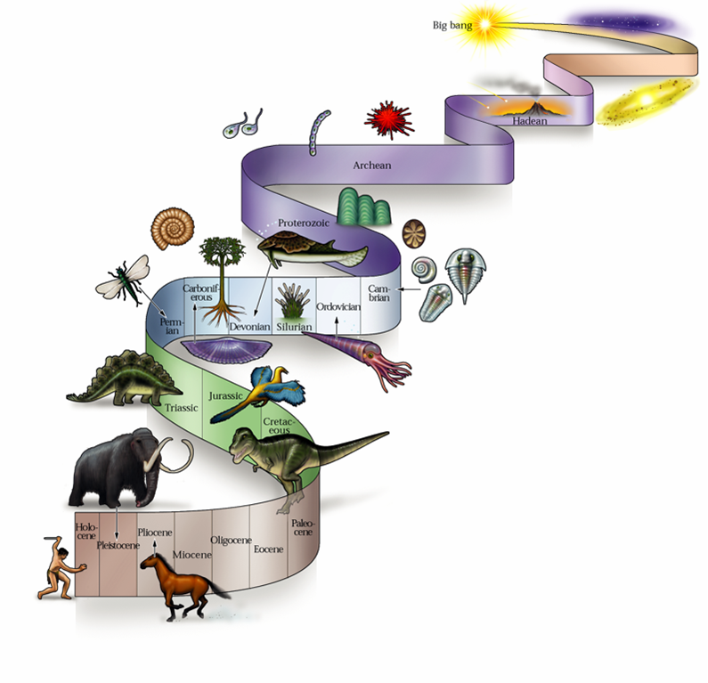
Evolutionary Inspiration
Biological systems result from
an evolutionary process
Biological systems are
robust
complex
adaptive
Evolutionary Computation attempts to copy process of natural evolution for automatic solution of complex problems
Does natural evolution generate increasingly complex systems?

Slide 28
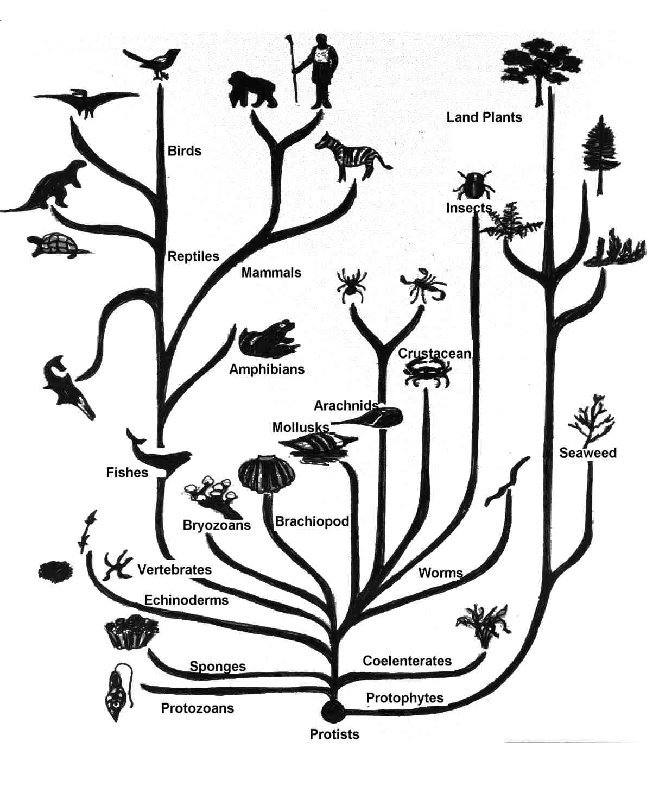
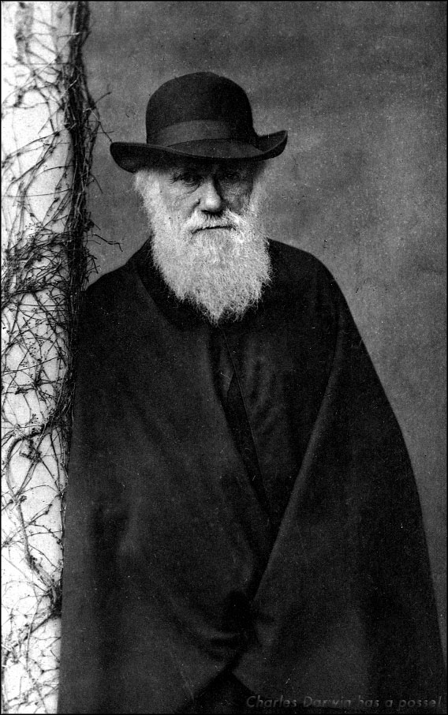
The 4 Pillars of Evolution
All species derive from
common ancestor
Charles Darwin, 1859
On the Origins of Species
Population
Group of several individuals
Diversity
Individuals have different characteristics
Heredity
Characteristics are transmitted over generations
Selection
Individuals make more offspring than the environment can support
Better at food gathering = better at surviving = make more offspring
Notes:
Describe the 4 pillars of evolution

Slide 29
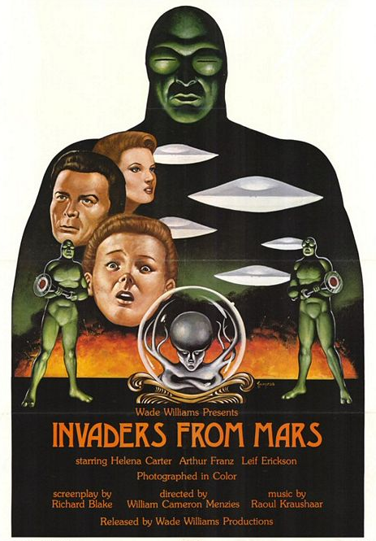
Evolution without Progress
… or “why we should not fear an invasion from Mars” (Gould, 1997)
Humans are not the top of the evolutionary ladder (misleading image of evolution with humans at top or end).
Evolution without Progress:
If no competition, no selection of the fittest
Individuals selected against current environment
Accumulation of change with no cost or benefit
(also known as Neutral Evolution)
Notes:
Describe natural situations where there may be evolution without progress

Slide 30
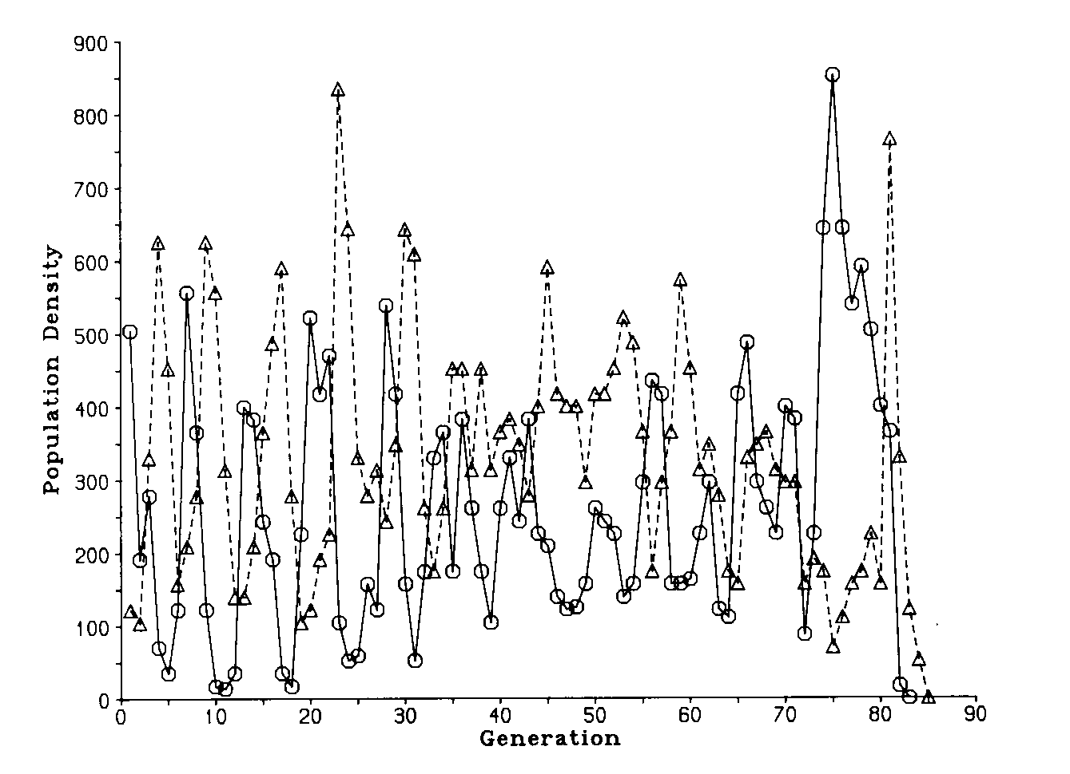
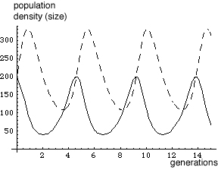
Models of Evolution
Biological models predict variations in population size or gene frequency, but not progress.
Ex: Lotka-Volterra model of
competitive co-evolution
dN1/dt=N1 (r1-b1N2)
dN2/dt=N2 (-r2+b2N1)
where:
- N1, N2 are the two populations
- r1 is increment rate of prey without predators
- r2 is death rate of predators without prey
- b1 is death rate of prey caused by predators
- b2 is ability of predators to catch prey
host
parasite
(Utida, 1957)
Notes:
What do biological models of evolution predict?

Slide 31
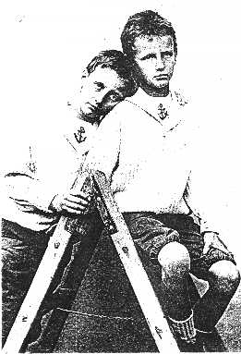
Phenotype & Genotype
Phenotype = the manifestation of the organism (appearance, behavior, etc.).
Selection operates on the phenotype;
It is affected by environment, development, and learning
Genotype = the genetic material of that organism.
It is transmitted during reproduction;
It is affected by mutations;
Selection does not operate directly on it
Genetics = structure and operation of genes
Functional genomics = role of genes in the organism
To what extent are we determined by genotype and phenotype?
Jean-Felix & Auguste Piccard
Notes:
What is phenotype and genotype?

Slide 32
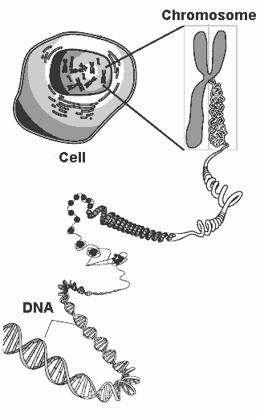
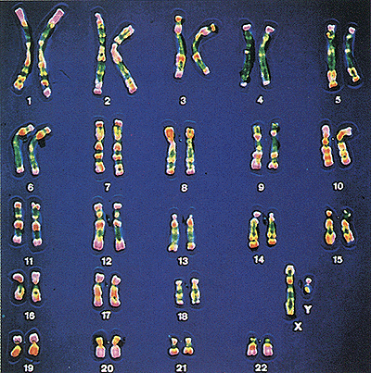
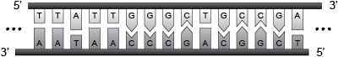
DNA (DeoxyriboNucleic Acid)
Long molecule, twisted in spiral, and compressed
Humans have 23 pairs of DNA molecules (chromosomes)
DNA is composed of 2 complementary sequences (strands) of 4 nucleotides (A, T, C, G), which bind together in pairs (A-T and C-G)
A gene is a sequence of several nucleotides that produce a protein
Notes:
Explain essential components of DNA

Slide 33
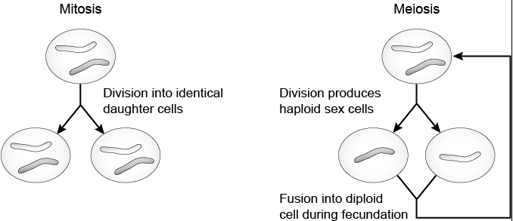
Cell Replication
Cells replicate in two ways:
Mitosis: during growth/maintenance of the organism
Meiosis: during production of sex cells
Notes:
Types of cell replication

Slide 34
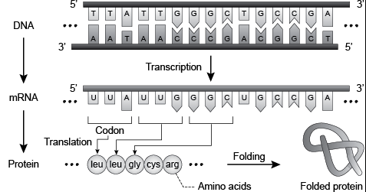
From Genes to Proteins (gene expression)
Proteins are molecules that define the type and function of cells (hair and muscle cells are made of different proteins).
The sequence of nucleotides in one strand defines the type of protein. The expression of the gene into a protein is mediated by another molecule, known as messenger RNA.
Notes:
Explain the three main steps of gene expression

Slide 35
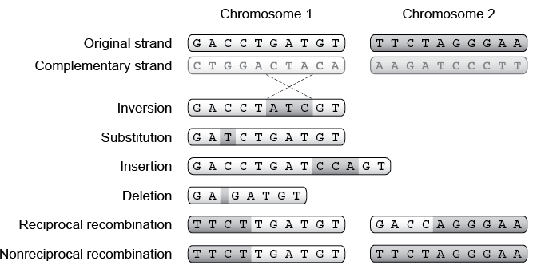
Genetic Mutations
Genetic mutations occur during cell replication (4⁻¹⁰ per nucleotide per year)
Those that occur in sex cells can affect evolution
Recombination is a mutation that affects two homologous chromosomes
Notes:
Describe some types of biological mutations

Slide 36
Artificial Evolution
Automatic generation of solutions to hard problems
Similarities between natural and artificial evolution:
Phenotype (computer program, object shape, electronic circuit, robot, etc.)
Genotype (genetic representation of the phenotype)
Population
Diversity
Selection
Inheritance
Differences between natural and artificial evolution:
Fitness is measure of performance of the individual solution to the problem
Selection of the best according to performance criterion (fitness function)
Expected improvement between initial and final solution
Notes:
What are the main similarities and differences between natural and artificial evolution?

Slide 37
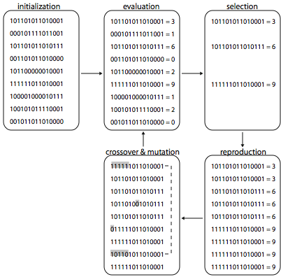
Evolutionary Algorithm
generation cycle
Devise genetic representation
Build a population
Design a fitness function
Choose selection method
Choose crossover & mutation
Choose data analysis method
Repeat generation cycle until:
maximum fitness value is found
solution found is good enough
no fitness improvement for several generations
Evolutionary algorithms are applicable to any problem domain as long as suitable genetic representation, fitness, and genetic operators are chosen.
Notes:
Describe the main steps of a generation cycle

Slide 38
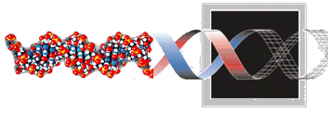
Genetic Representation
Describes elements of genotype and mapping to phenotype
Must match genetic operators of recombination and mutation
Set of possible genotypes should include optimal solution to the problem
Choice of representation benefits from domain knowledge:
Encoding of relevant parameters
Appropriate resolution of parameters
1001101010001
Great simplification of genetics:
Single stranded sequence of characters (e.g., binary)
Fixed length, only genic
Often haploid structure and one chromosome
Often one-to-one direct correspondence between gene and parameter
Gene expression and genetic regulation used only in specific situations

Slide 39
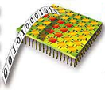
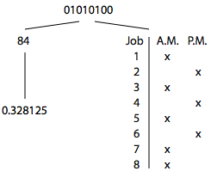
Discrete Representations
A sequence of l discrete values drawn from alphabet with cardinality k
E.g., binary string of 8 positions (l=8, k=2): 01010100
Can be mapped into several phenotypes:
to configuration string of
FPGA electronic circuits
to integer i using
binary code
to job schedule:
job=gene position
time=gene value
to real value r in range [min, max]:
r = min + (i/255)(max-min)
Notes:
What is a discrete representation?
Into what phenotypes a binary genotype can be mapped?
Describe how to represent a real value with a binary representation
Describe how to represent a job schedule with a binary representation

Slide 40
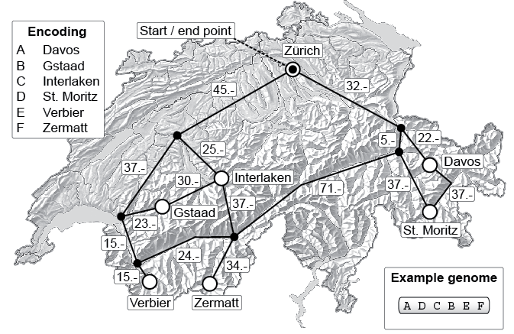
Sequence Representation
It is a particular case of discrete representation used for class of Traveling Salesman Problems (plan a path to visit n cities under some constraints). E.g., planning ski holidays with lowest transportation costs
Notes:
Describe how to represent a sequence with a discrete representation

Slide 41
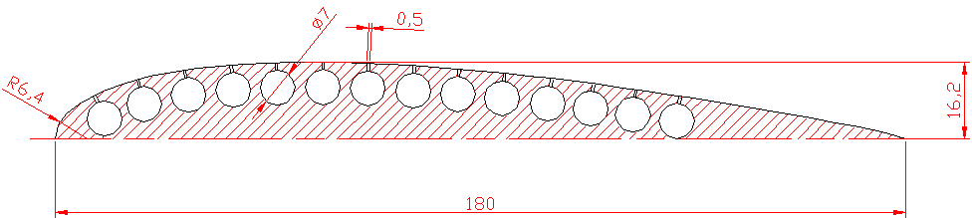
Real-Valued Representation
Genotype is sequence of real values that represent parameters
Used when high-precision parameter optimization is required
For example, genetic encoding of wing profile for shape optimization
:
Evolvable wing made of deformable
material with pressure tubes
Genotype= pressure values of 14 tubes
Alternatively, encode values of variables of equations describing profile
Notes:
What are real-valued representations and when may be used?

Slide 42
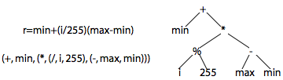
Tree-based Representation
Genotype describes a tree with branching points and terminals
Suitable for encoding hierarchical structures
E.g., used to encode computer programs
Computer program is made of:
Operators (Function set: multiplication, If-Then, Log, etc.)
Operands (Terminal set: constants, variables, sensor readings, etc.)
root
Expression
Nested list
terminals
Closure: all functions must accept all terminals in Terminal set and outputs of all functions in Function set (e.g., protected division %)
Sufficiency: elements in Function and Terminal sets must be sufficient to generate program that solves the problem
Notes:
Describe tree-based representations

Slide 43
Initial Population
Sufficiently large to cover problem space (!), but sufficiently small for evaluation costs (typical size: between 10s and 1000s individuals)
Uniform sample of search space:
Binary strings: 0 or 1 with probability 0.5
Real-valued representations: uniform on a given interval if bounded phenotype (e.g., +2.0, -2.0); otherwise best guess or binary string with dynamic mapping resolution (Schraudolph and Belew, 1992; Dürr et al, 2007)
Trees are built recursively starting from root: root is randomly chosen from function set; for every branch, randomly choose among all elements of function set and of terminal set; if terminal is chosen, it becomes leaf; set maximum depth of tree.
Mutated clones of previously evolved genotype or hand-designed genotype:
Possible loss of genetic diversity
Possible unrecoverable bias
Notes:
Describe the methods to create the initial population

Slide 44
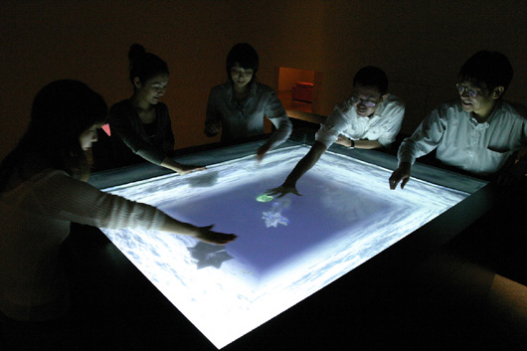
Fitness Function
Evaluates performance of phenotype with a numerical score
Choice of components; e.g., lift and drag of wing
Combination of components; e.g. (lift + 1/drag) or (lift - drag)
Extensive test of each phenotype
Warning! You Get What You Evaluate (example in application, later)
Subjective fitness: select phenotype by visual inspection
Used when aesthetic properties cannot be quantified objectively
Can be combined with objective fitness function
"A-Volve”, Sommerer and Mignonneau,
NTT ICC Tokyo Opera House, www.ntticc.or.jp
Notes:
What is a fitness function?

Slide 45
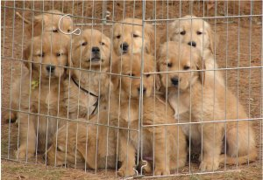
Selection
A method to make sure that better individuals make comparatively more offspring
Used in artificial evolution and breeding
Selection pressure is inversely proportional to nr. of selected individuals
High selection pressure = rapid loss of diversity and premature convergence
Make sure that also less performing individuals can reproduce to some extent

Slide 46
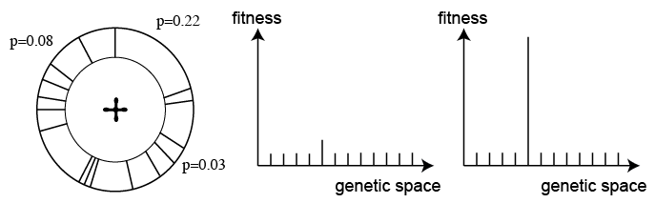
Proportionate Selection
The probability that an individual makes an offspring is proportional to how good its fitness is with respect to the population fitness: p(i) = f(i)/Σf(i)
Also known as Roulette Wheel selection
Problems:
Uniform fitness values = random search
Few high-fitness individuals = high selection pressure
Notes:
Describe proportionate selection
When does proportionate selection fail and why?

Slide 47
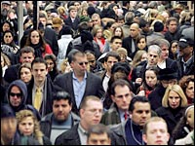
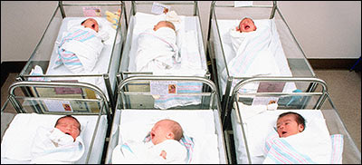
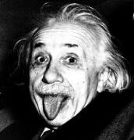
Replacement
Generational replacement: old population is entirely replaced by offspring (most frequent method)
Elitism: maintain n best individuals from previous
generation to prevent loss of best individuals by
effects of mutations or sub-optimal fitness evaluation
Generational rollover: insert offspring at the place of worst individuals
Notes:
What is elitism?

Slide 48
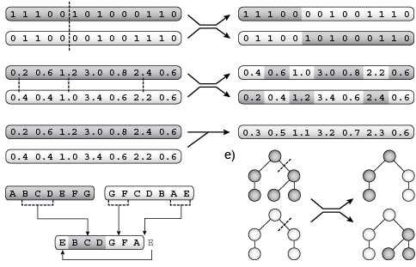
Crossover
Emulates recombination of genetic material from two parents during meiosis
Exploitation of synergy of sub-solutions (building blocks) from parents
Applied to randomly paired offspring with probability p_{c}(pair)
One point
Uniform
Arithmetic
For
trees
For sequences
Notes:
Describe types of artificial crossover for different representations

Slide 49
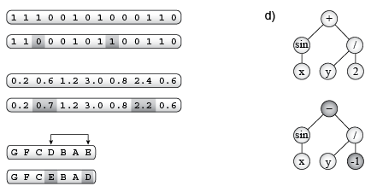
Mutation
Emulates genetic mutations
Exploration of variation of existing solutions
Applied to each character in the genotype with probability p_{m}(char)
For trees
Binary genotypes
Real-valued genotypes
Sequence genotypes
Notes:
Describe types of artificial mutations for different representations

Slide 50
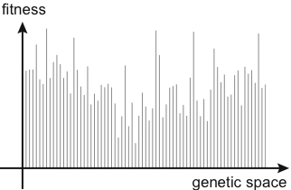
Assessing Fitness Landscape
Fitness landscape is a plot of fitness values associated to all genotypes
Real landscape is unknown; estimation helps to assess evolvability
Goal of evolution is to find genotype with best fitness
Navigation depends on genetic operator; landscape metaphor is misleading
Estimating ruggedness of real landscape:
Sample random genotypes: if flat, use large populations
Explore surroundings of individual by applying genetic operators in sequence for fixed number of times: the larger the fitness improvement the easier is to evolve
Notes:
What is the fitness landscape?

Slide 51
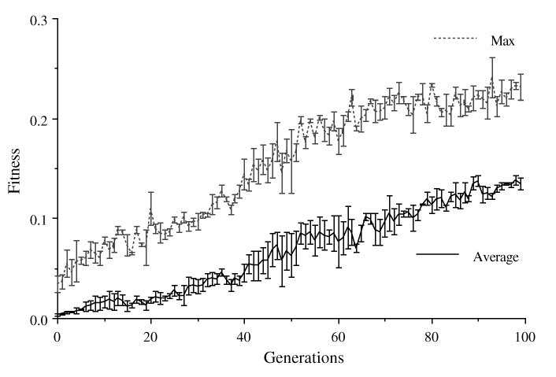
Monitoring Performance
Track best and population average fitness of each generation
Multiple runs are necessary: plot average data and standard error
Fitness graphs are meaningful only if the problem is stationary!
Stagnation of fitness function may mean best solution found or premature convergence
Notes:
How can we monitor performance of an evolutionary algorithm?

Slide 52
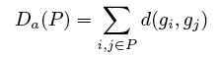
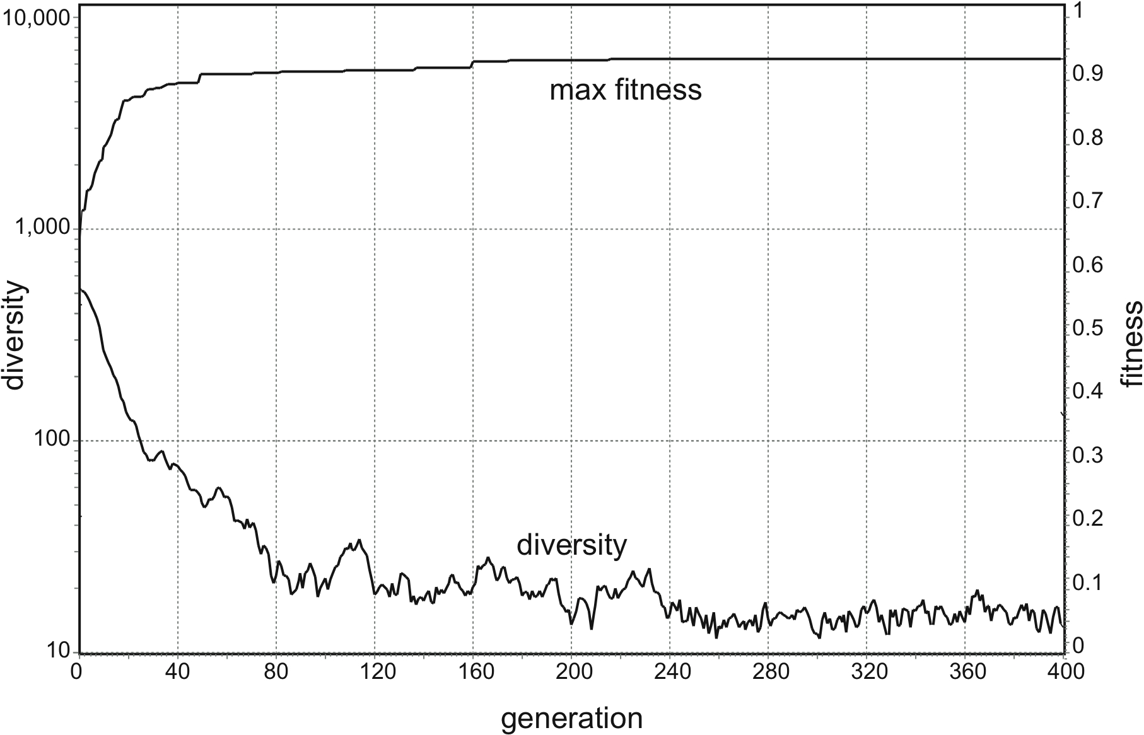
Measuring Diversity
Diversity tells whether the population has potential for further evolution
Measures of diversity depend on genetic representation
E.g., for binary and real valued, use sum of Euclidean or Hamming distances
Notes:
Why is it important to monitor diversity?

Slide 53
Applicability
Evolutionary algorithms are used in a huge number of problems
Biological inspiration is essential, but often distorted
Different problems may require different algorithms
algorithm
performance
EA2
EA1
EA3
problem type
Knowledge of problem domain can help to choose or assemble best algorithm
Notes:
What is the best evolutionary algorithm?

Slide 54
Major Evolutionary Algorithms
Genetic Algorithms (GA) - Holland, 1975
Binary genotypes, crossover and mutation
Genetic Programming (GP) - Koza, 1992
Tree-based genotypes, crossover and mutations
Evolutionary Programming (EP) - Fogel etal., 1966
Real-valued genotypes, mutations, tournaments, gradual pop. replacement
Evolutionary Strategies (ES) - Rechenberg, 1973
As EP + mutation range encoded in genotype of individual
Island Models – Whitley et al., 1998
Parallel evolving populations with rare migration of individuals
Steady-State Evolution – Whitley et al., 1988
Gradual replacement: Best individuals replace replace worst individuals
Notes:
Major types of Evolutionary Algorithms

Slide 55

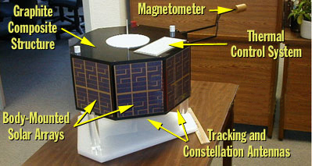
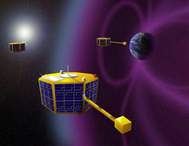
Application: Antenna for Nanosatellites
ST5 mission: Measure effect of solar activity on the Earth's magnetosphere
3 nanosatellites (50 cm)
Design of antenna to send data to ground station
[Lohn, Hornby, Linden, 2004]

Slide 56
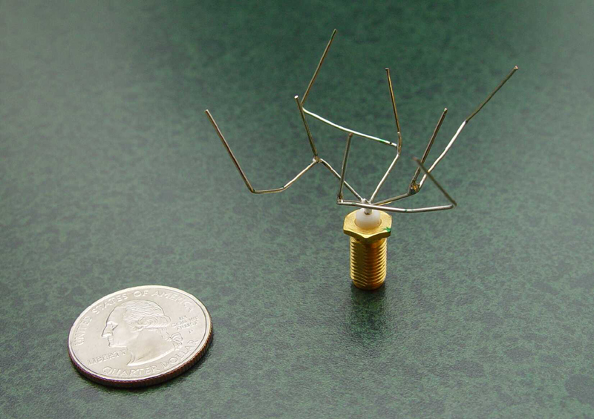
Genetic Representation
Tree-based Encoding
Execute instructions from root to leaves
Evaluate fitness according to specs in simulation
Build best and test in anechoic chamber
5.0cm
Function Set
f = forward (length, radius)
r x/y/z = rotate x/y/z
Terminal Set
Length, radius, x, y, z
Constraint:
max. 3 branches for each f node
f
rx
f
Feed Wire
2.5cm
f
rz
rx
Evolved antenna:
f
f
Notes:
How could we genetically encode an antenna design?

Slide 57
Wrapping up:

Slide 58
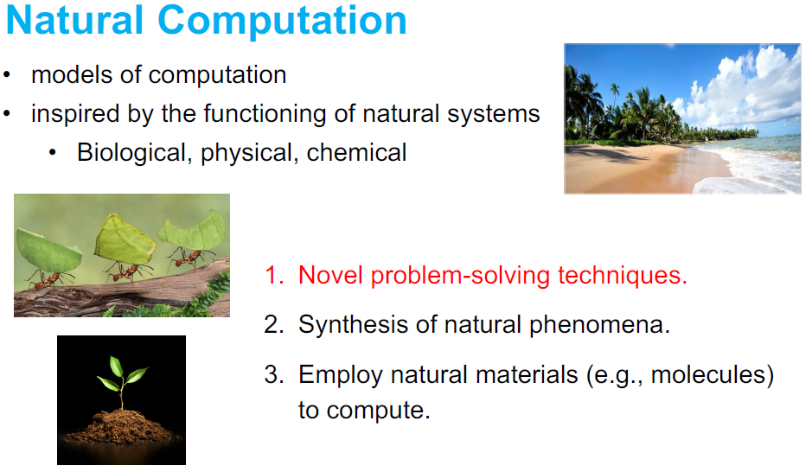

Slide 59
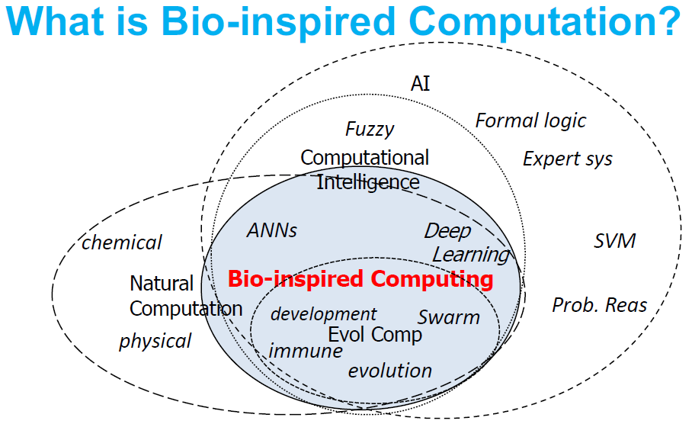
The phrases “Bio-inspired computation” and “Bio-inspired AI” are not entirely well-defined. But that’s okay. Here is a take on what “Bio-inspired computation” is, from the 2019 version of this course.

Slide 60
Focus in this Course
Natural
Computation
Bio-Inspired AI
Optimization
Focus in this course
Evolutionary
Algorithms
Stochastic
Optimization
Here is my take on what “Bio-inspired AI” is as well as the focus of this 2022 version of this course.

Slide 61
Your Help and Support
Theory or project (exercise) help
Attend the lectures, ask questions!
Re-read lecture material (slides)
Carefully read the recommended reading, including text books and project assignments with references
Attend lab hours and ask questions (with teaching assistants)
Discuss within your project team
Form reading groups, discuss with other students
Post questions on Blackboard
Administrative help and other issues
Contact coordinating TAs (Anum, Helle)
Contact lecturers (me or Xavier)

Slide 62
Reference Group - Reminder
Need ~3 students to take part in 2 meetings this semester
Minimal time commitment
Need to make yourself available to other students
So that you can represent your own and their inputs to the course
Benefits:
Impact on the course this and later semesters
Valuable collaboration and connections
Sign up at break, after the lecture, or by email:
ole.j.mengshoel@ntnu.no
xavier.sanchezdz@ntnu.no

Slide 63
In Conclusion:
Welcome to IT3708 – “Bio-Inspired Artificial Intelligence”!

Slide 64
Questions?
Faculty

